Slide 1
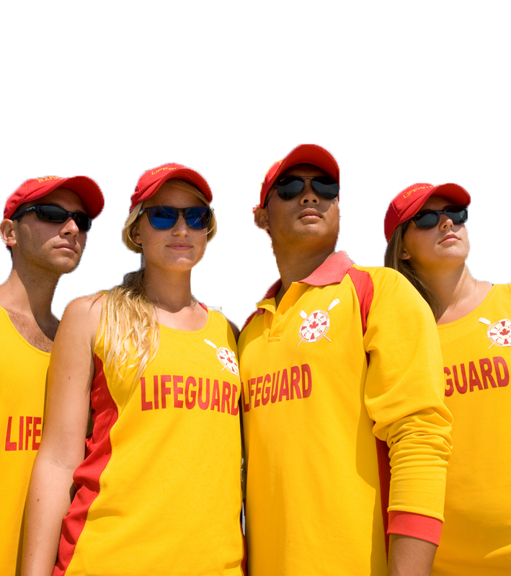
Self-Learning Guide
National Lifeguard Instructor
Notes:
This Self-Learning Guide is for National Lifeguard Instructors who wish to acquaint themselves with the updated program on their own time. It requires the Instructor to have the revised National Lifeguard Award Guide in hand.
There is no credit value for Instructors going through the Self-Learning Guide on their own. There is a value of 1 credit available for those who participate in a synchronous (online, blended or in-person) Affiliate or Branch-delivered National Lifeguard Instructor Update that is led by a Trainer who has completed a National Lifeguard Instructor Trainer Update. The Affiliate must submit a master sheet to the Society for processing.

Slide 2
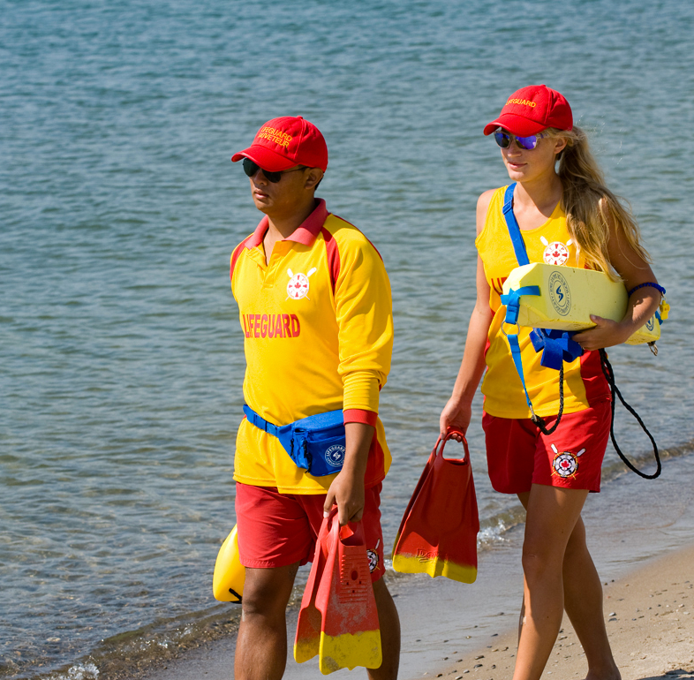
Session 1:
Introduction

Slide 3
National Lifeguard Instructor Self-Learning Guide
How to use the Self-Learning Guide:
Get and use the new National Lifeguard Award Guide (2022).
Read the content on the slides and the corresponding notes.
Make notes and write down your questions.
If you have questions as you review the Guide, it’s recommended that you either:
Attend a synchronous Instructor Update Clinic (this forum allows for questions to be answered by a Trainer), or
Send us an email: training@lifeguarding.com
NLI Self Learning Guide
Notes:
If you prefer a printed version to review
You can review this Guide without printing any paper. If you prefer to review this Guide as a printed version, then print this PowerPoint in “Notes Pages” format to ensure both the slide and corresponding notes are printed.

Slide 4
National Lifeguard Instructor Self-Learning Guide
Self-Learning Guide:
To provide National Lifeguard Instructors with an alternate method of updating their knowledge required to teach the updated National Lifeguard program.
Updated National Lifeguard Award Guide:
For this Self-Learning Guide to be effective for you as a National Lifeguard Instructor, you must have the new National Lifeguard Award Guide to use and reference.
NLI Self Learning Guide

Slide 5
National Lifeguard Instructor Self-Learning Guide
Topics:
Introduction
National Lifeguard Program Update & Resources
Introduction to New and Modified Items
Management of Spinal-Injured Victim
Single Lifeguard Situations
Next Steps
NLI Self Learning Guide

Slide 6
Session 2:
NL Program Update & Resources
Notes:
Notes:
Ensure you have, use and reference the National Lifeguard Award Guide.
Example: In National Lifeguard Pool, Item 8C is on page 15, called Pool supervision: prevention and intervention
Ensure that you have the NLAG out and ready to reference.

Slide 7
National Program Revision: National Lifeguard
National Lifeguard Program Update (Summary)
National Lifeguard is a national program
5-year Revisions Cycle (started April 2019)
National Lifeguard Program Update finalized in 2021
Lifesaving Society Ontario launching December 2022
New National Lifeguard Award Guide & test sheets (course + recert)
April 2019
Review
Revise
Update
Today
Launch
NLI Self Learning Guide
Notes:
Purpose of this slide is to highlight the key benefits of revising the NL training program. These are the highlights of how changes to lifeguard standards were developed.
Notes:
The Lifesaving Society reviews and revises the National Lifeguard training program on a regular basis to ensure it remains relevant to the needs of lifeguard employers and remains current with North American and international best practices.
Regular revision ensures that the Society provides an up-to-date, reasonable, comprehensive and balanced program for professional lifeguarding training in Canada. (Important to talk about the program is for professionals. Professionals who practice and work on their skills/fitness to perform at or above standards every time).
The National NL Revisions Committee, with representation from all Branches, reviewed the NL curriculum. Changes were presented for the approval of the Lifesaving Society national board of directors.
Great care was taken to review the lifeguard programs and standards from Royal Life Saving Society Commonwealth and surf lifesaving nations, the standards of the International Life Saving Federation and the work of the United States.

Slide 8
National Program Revision: National Lifeguard
Three key areas requiring change emerged:
Physical standards were revised to ensure they were measurable and met criteria as per Canadian Human Rights Commission recommendations.
Management items were reviewed to reflect current research.
Lifeguard situation items were reviewed to address pass/fail data and to improve the transition from Bronze Cross (Assistant Lifeguard) to National Lifeguard.
NLI Self Learning Guide
Notes:
Changes are based on the 3 key areas:
Demonstrated need – e.g. reflects the needs and requirements to meet criteria set out by Canadian Human Rights Commission which includes adjustments to some items. 2 examples include:
Rescue drill has been removed from the “physical standard” category and has become a skill item rather then an item that must be completed within a specific time frame. Candidates in the course are now empowered to select their own victim, rather then the former verbiage of “selecting a victim relatively their own size” as this can be perceived as discriminatory.
The physical standards (4) are all now completed without equipment requirements and victims (i.e. endurance challenge, sprint challenge, underwater swim) or very specific equipment (i.e. object recovery). There is no more variability regarding the use of other candidates as victims.
Research based – e.g. reflects current research, international standards and best practices. The management items were reviewed to ensure there is a focus on priorities such as life-over-limb principle when it comes to management of spinal-injured victim as well as incorporating the need for a lifeguard to become proficient in the use of various buoyant and non-buoyant rescue aids.
Lifeguard situation items – e.g. the cumulative skills required for a lifeguard to successfully perform during lifeguard situations were reviewed and modified to ensure best practices were maintained and skills streamlined efficiently from Bronze Cross (Assistant Lifeguard) to National Lifeguard.

Slide 9
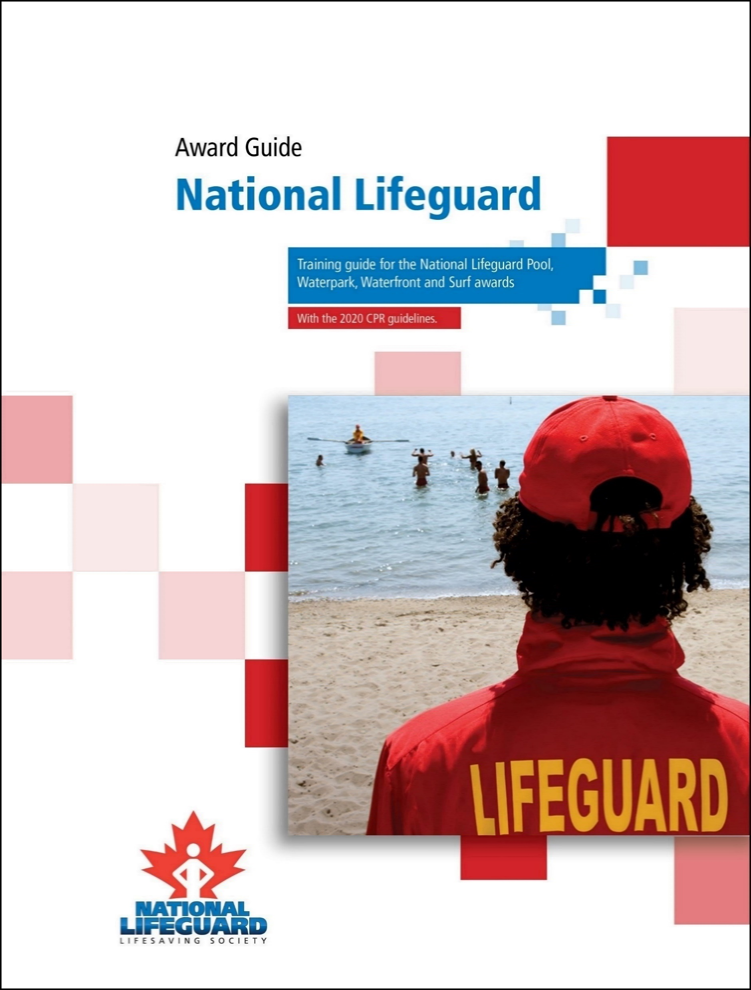
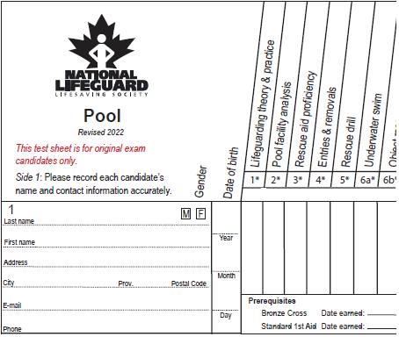
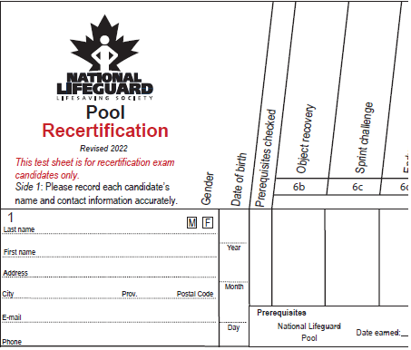
What’s New?
Resources:
National Lifeguard Award Guide (2022)
Test sheets (course + recertification)
Teaching National Lifeguard USB
NL Recertification: Notes for Examiners
NL Examination Policy (effective January 1, 2023)
NLI Self Learning Guide
Notes:
Notes:
Recently adopted 2020 international resuscitation guidelines have been folded into the updated NL program.
Introduce the revised award guide with a focus on the “Foreword” (page iii):
Purpose statements: specify the why the item is included.
Learning outcomes: define what the candidate is expected to know, understand/or be able to demonstrate.
Must Sees: criteria define the performance standard at which the candidate must perform to be successful.
Take a moment now to read the “What’s new in this Edition” (page vi-viii).
Also read the information on our website under the National Lifeguard subpage: https://www.lifesavingsociety.com/lifeguarding/national-lifeguard.aspx
Take a moment to read the National Lifeguard Examination Policy located on our website.
Reference link: http://www.lifesavingsociety.com/lifeguarding/national-lifeguard/national-lifeguard-examination-policy.aspx
About the Policy:
The National Lifeguard Examination Policy (effective January 1, 2023) is a policy of the Lifesaving Society Ontario for NL Instructors and NL Examiners. The Policy defines the minimum conditions under which National Lifeguard examinations may occur:
NL test sheets may only be submitted by an Affiliate Member.
Minimum pool facility specs.
Minimum equipment required and accompanying descriptions.
Minimum number of candidates.
Minimum lifeguarding situations required.
Minimum number of potential victims.
Mandatory items on recertifications

Slide 10
Key Changes
Summary:
Single lifeguard and team situations
New Rescue Aid proficiency item
Measurable physical standard items
Victim management items revised
Lifeguard knowledge items added
Appendix A is updated
NLI Self Learning Guide
Notes:
Notes:
Each of these topics will be reviewed in this Self-Learning Guide.

Slide 11
Key Changes
New Items introduced:
Rescue aid proficiency (Pool + Waterfront)
Endurance swim (Waterfront + Surf)
Sprint challenge (Waterfront + Waterpark)
Object recovery (Waterpark)
NLI Self Learning Guide
Notes:
Notes:
The following are items being introduced into the National Lifeguard program

Slide 12
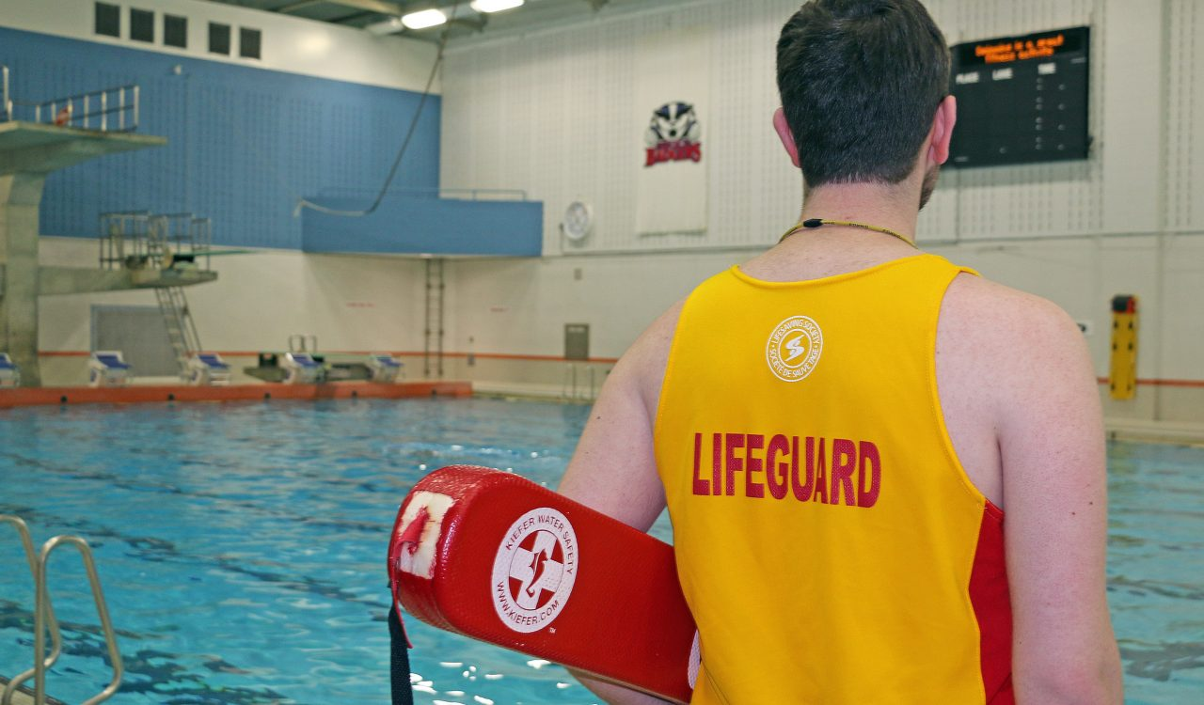
Key Changes
1. Single Lifeguard and Team Situations
This topic will be further explored in Session 5
NLI Self Learning Guide

Slide 13
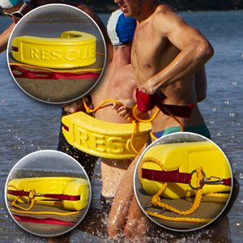
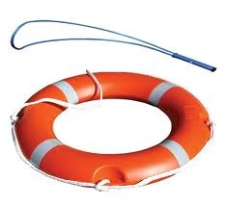
Key Changes
2. New Rescue Aid Proficiency item:
Designed to demonstrate candidates’ mastery of this fundamental lifeguard competency, which is particularly important in single-lifeguard situations.
This topic will be further explored in Session 3
NLI Self Learning Guide

Slide 14
Key Changes
3. Physical standard items:
All physical standards now have measurable time, distance and weight requirements.
Fitness items (in which candidates carried a victim) have been retired, repurposed or absorbed into other skill items.
For example: the “spinal carry” is retired and “rescue drill” is now a skill item with no time requirement.
Principle: All physical standards are to be objective and standardized.
NLI Self Learning Guide

Slide 15
Key Changes
Physical Standards
NL Pool
NL Waterfront
Endurance Challenge
Underwater Swim
Object Recovery
Sprint Challenge (Revised)
Endurance Challenge (NEW)
Sprint Challenge (NEW)
NL Waterpark
NL Surf
Object Recovery (NEW)
Sprint Challenge (NEW)
Endurance Challenge (NEW)
Run-Swim-Run
NLI Self Learning Guide
Notes:
Notes:
The Endurance Challenge in Pool, Waterfront and Surf are all the same (400 m in 10 minutes)
The Endurance Challenge can be done in any water setting (regardless of the option). This means that you can do this item in a pool if it is a waterfront or surf course

Slide 16
Key Changes
4. Victim management items:
Candidates may choose their own victims in the distressed or drowning, non-breathing and spinal-injured victim items.
The distressed or drowning victim item is performed with and without an aid.
Spinal-injured victim item now includes breathing and non-breathing victims.
This topic will be further explored in Session 4
NLI Self Learning Guide
Notes:
Notes:
Using the Award Guide, note the first bullet point on the list: "Where possible, candidates should practice with a variety of victim types and over various distances to learn about their personal limitations."

Slide 17
Key Changes
5. New Items introduced
Knowledge of the benefits of bag-valve masks and suction (Item 1).
The ability to identify appropriate lifeguard supervision zones is now a Must See requirement in positioning and rotation items.
NLI Self Learning Guide

Slide 18
Key Changes
6. Appendix A updated with first aid and CPR protocols
Appendix A first aid requirements feature some additions and minor updates to ensure continued consistency with Canadian standards and current ILCOR guidelines.
NLI Self Learning Guide
Notes:
CSA = Canadian Standards Association sets out workplace first aid standards across Canada.
ILCOR = The International Liaison Committee on Resuscitation (ILCOR) was formed in 1992 to provide a forum for liaison between principal resuscitation organizations worldwide.

Slide 19
Key Changes – Other
Updated “Must Sees”
Some items have not changed but their “Must Sees” have been updated or refined for accuracy, clarity and achievability.
NLI Self Learning Guide

Slide 20
Key Changes – Other
New test sheet for Recertifications
Original course test sheet
Recertification test sheet
NLI Self Learning Guide
Notes:
Notes:
Available for download in “Find a Form”.
Both 2012 and 2022 test sheets will be available for the duration of 2023.
All courses and recertifications must transition to the new test sheets no later than December 31, 2023.

Slide 21
Key Changes – Retired Items
Items retired
Spinal carry (Waterpark)
Approach and carry (Pool + Waterpark)
Victim carry (Waterfront + Surf)
Run-swim-tow (Waterfront + Surf)
NLI Self Learning Guide

Slide 22
National Lifeguard Exam Policy (January 1, 2023)
www.LifesavingSociety.com
NLI Self Learning Guide
Notes:
Navigate to the website, to review the National Lifeguard Exam Policy (effective January 1, 2023).
https://www.lifesavingsociety.com/ and then navigate accordingly.

Slide 23
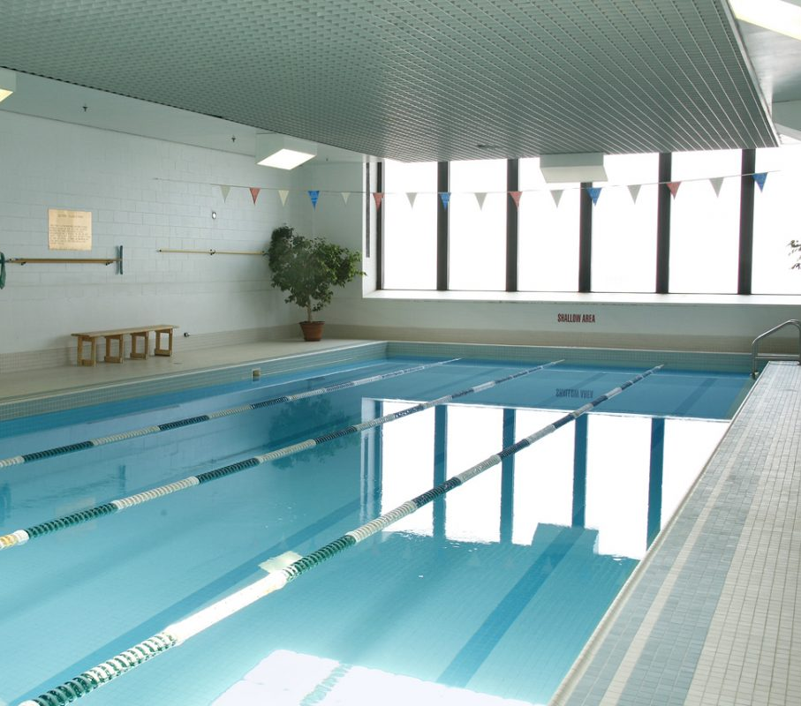
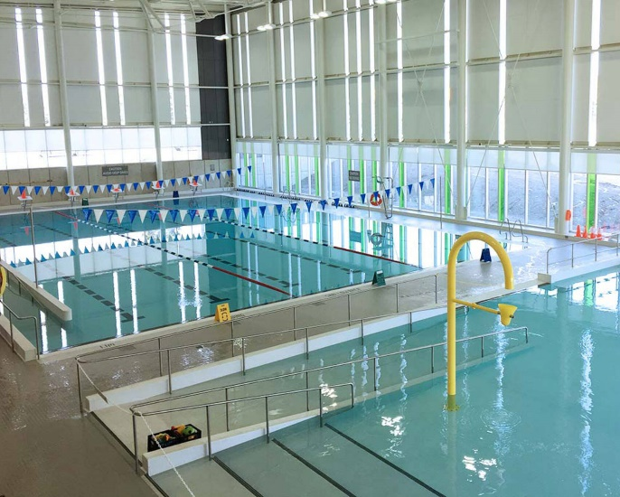
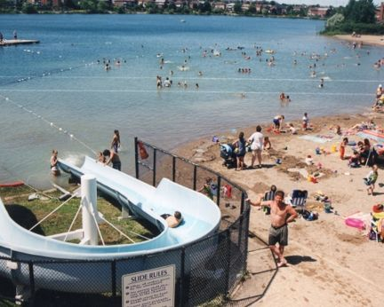
Course Location Requirements
Pool:
A body of water that is a minimum of 15 m in length, 5 m in width and a minimum of 1.5 m in depth (3 m preferred) at the deepest end.
NLI Self Learning Guide

Slide 24
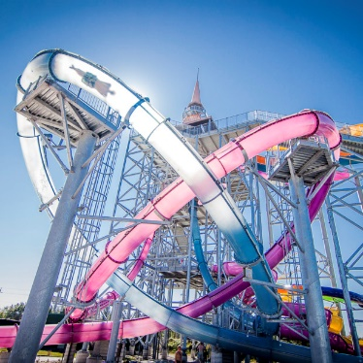
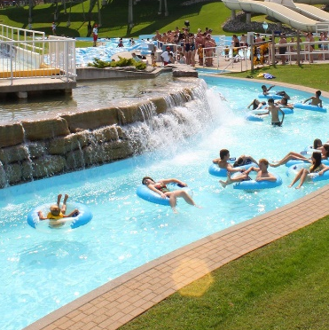
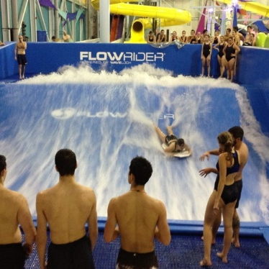
Course Location Requirements
Waterpark:
An aquatic facility or swimming pool with a minimum of:
Three (3) types of basins or zones (e.g., swimming pool, wave pool, catch basins, river ride),
Three (3) aquatic features with moving water or moving riders such as a wave pool, water slide (minimum 3 m in height), and other activity (e.g., river ride, flow rider, inflatable waterpark, zip line, rope swing).
NLI Self Learning Guide

Slide 25
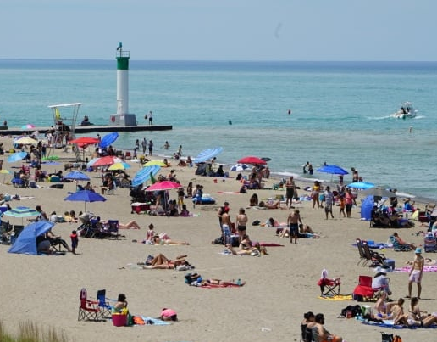
Course Location Requirements
Waterfront:
An open water environment with beach access.
NLI Self Learning Guide

Slide 26
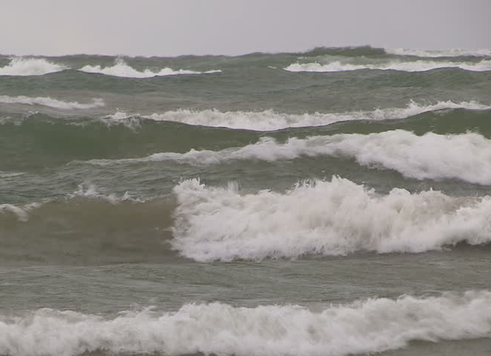
Course Location Requirements
Surf:
An open water environment with beach access and:
A minimum wave height of 1 m at least 60% of the time,
Two (2) ocean features such as tides, currents and wave-breaking zones.
NLI Self Learning Guide
Notes:
Context for “60% of the time”
Includes 60% of course time and 60% of the exam time

Slide 27
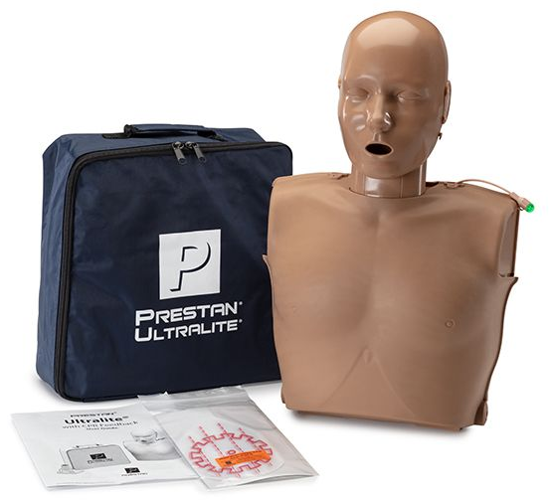
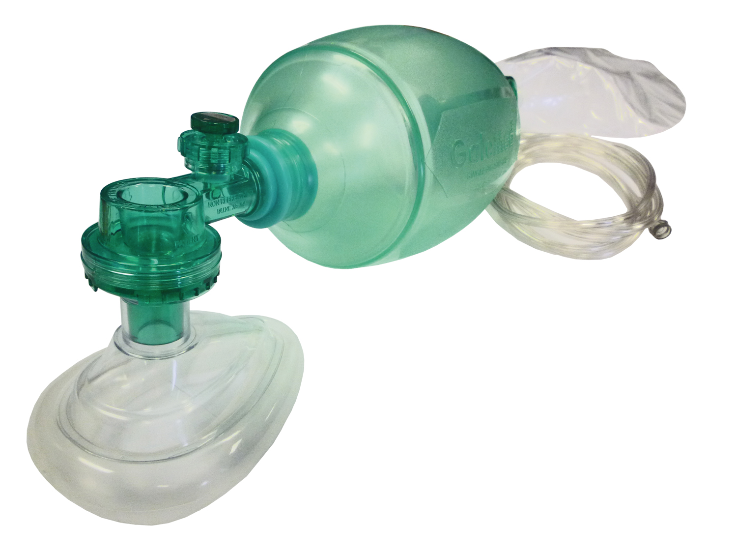
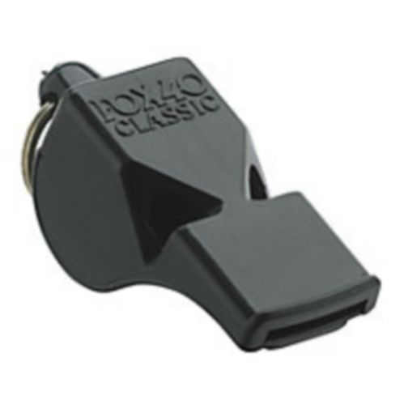
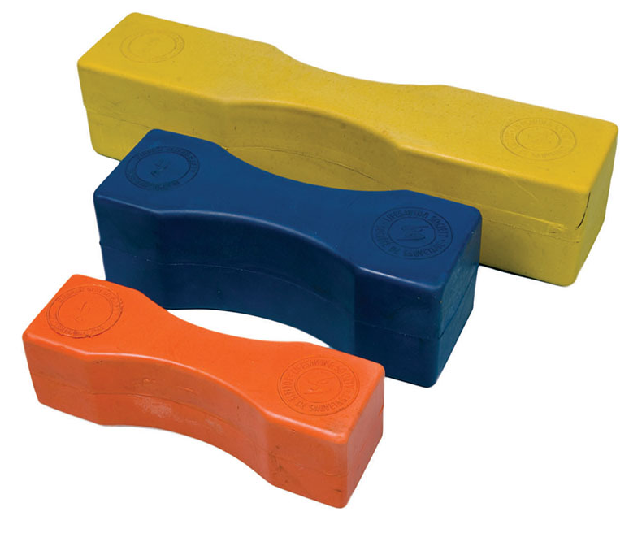
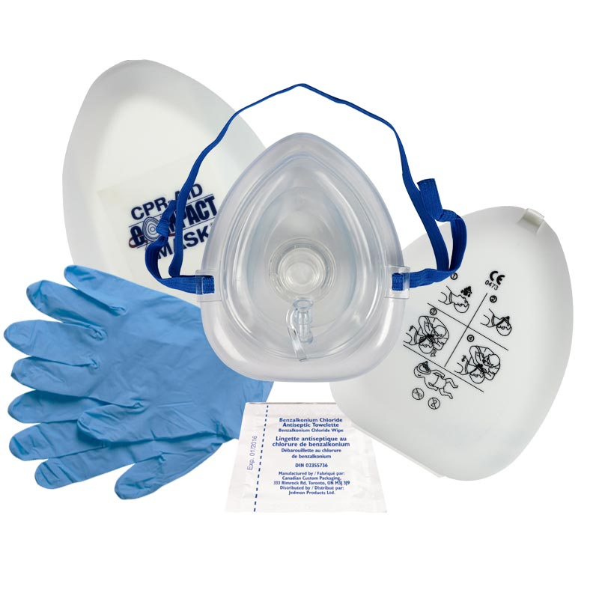
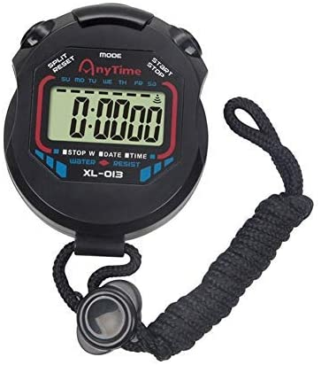
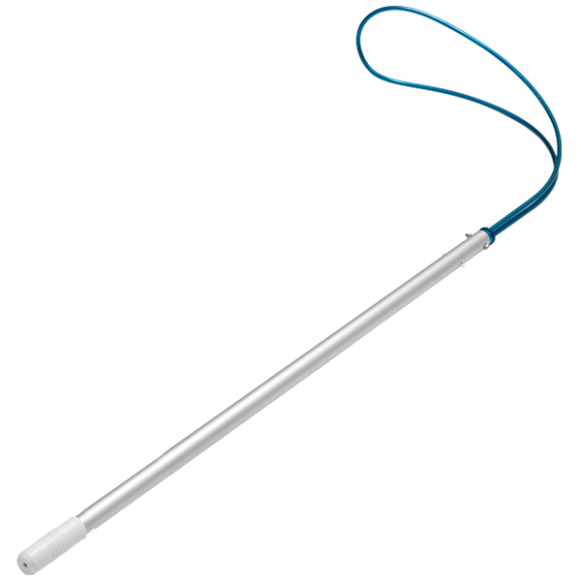
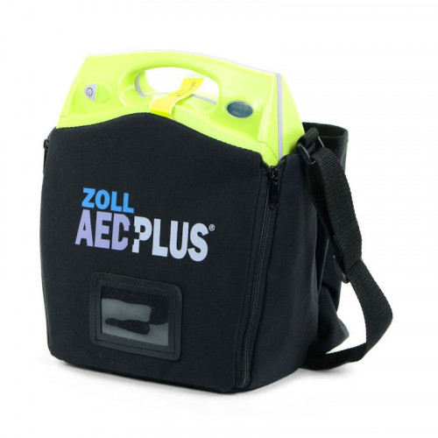
Equipment Requirements
 | X = Mandatory O = Optional
Equipment List | Pool | Waterpark | Waterfront | Surf
Resuscitation manikin | X | X | X | X
Barrier devices | X | X | X | X
Practice First Aid kit | X | X | X | X
Buoyant rescue aids | X | X | X | X
Non-buoyant rescue aids | X | X | X | X
Spineboard | X | X | X | X
9 kg (20 lbs) weight | X | X | X | X
Whistles | X | X | X | X
Timing device | X | X | X | X
AED trainer | O | O | O | O
Bag-Valve-Mask | O | O | O | O
Submersible manikin | O | O | O | O
Distance measuring device (100-200 metres) | -- | -- | X | X
Masks, fins, and snorkels | -- | -- | X | X
Paddleboard or rescue craft | -- | -- | X | X
NLI Self Learning Guide
Notes:
Equipment checklist:
Think about the rationale for why these items have been included in the updated National Lifeguard Examination Policy.
This is a checklist of items NL Instructors should have when preparing to teach the updated NL course.
Notes:
This is the minimum requirements that all courses must have or are options, and although the quantity is not prescribed (e.g. X# of rescue tubes), it is encouraged to have an adequate supply according to the number of candidates in the course
It is strongly advised to ensure AED trainers are available as well as BVMs (especially as we continue to navigate transmission of communicable viruses such as Influenza, COVID, etc.)
Beyond the equipment list on the slide, Instructors require the following items as additional to the list provided above:
Alert manual with Alert Insert
Revised National Lifeguard Award Guide
Revised National Lifeguard test sheets
First aid supplies contained within the practice first aid kit
Minimum length, width and pool depth
Victims, if less than the required number of people required

Slide 28
National Lifeguard Recertification Items
Item | Pool | W’park | W’front | Surf
Physical Standard: Object recovery | P | P
Physical Standard: Sprint challenge | P | P | P
Physical Standard: Endurance challenge | P |  | P | P
Pool Supervision: positioning and rotation |  | P
Pool Supervision: scanning and observation | P | P | P | P
Management of distressed or drowning victim | P | P | P | P
Management of submerged, non-breathing victim | P | P | P | P
Management of spinal-injured victim |  | P |  | P
Management of an injured victim | P | P | P | P
Lifeguard situation: single guard | P |  | P
Lifeguard situations: team | P | P | P | P
Use of rescue craft |  |  | P | P
NLI Self Learning Guide
Notes:
Download the NL Recertification Notes for Examiners from the National Lifeguard > Resources page of our website to review the required items that must be covered in the revised National Lifeguard Recert. Please note that these are the items; no additions, no omissions. The Examiner may not ask candidates to perform other items at the Examiner’s discretion, or choose not to evaluate an item.
The Management of an injured victim item and the Supervision: scanning and observation item may be evaluated separately or within lifeguarding situations (single lifeguard and/or lifeguard team).
The Society has produced separate National Lifeguard test sheets for use on original courses and recertification exams. They are available as fillable PDFs. Recertification test sheets feature only the mandatory items evaluated in a recertification. These are posted on “Find a Form” on our website.
Additionally:
Design situations to be realistic, selected from the suggested list in the NL Recertification Notes for Examiners.
The NL Recert exam must follow the list of victim types for major and minor lifeguard situations as outlined in the NL Recertification Notes for Examiners and Appendix A of the National Lifeguard Award Guide.
The majority of situations should occur in the water.
Additional lifeguard education or specific topics or techniques added by the Lifesaving Society Branch, the Affiliate or the NL Instructor may not form part of the candidate’s evaluation for NL certification.

Slide 29
Implementation Timeline
Who | What | By When
National Lifeguard Instructors & Trainers | Get yourself updated, by completing one of the update methodologies. See website for more information | Dec 31, 2023
Who | What | By When
Lifesaving Society | All resources shipped are updated resources (new Award Guide, new Teaching National Lifeguard USB) | Immediately
Who | What | By When
Affiliate | All NL Instructor courses and NL courses may begin to use the updated program and materials | Dec 15, 2022
Affiliate | All NL Instructor courses should transition to using updated content immediately, but no later than | March 31, 2023
Affiliate | Full implementation deadline | Dec 31, 2023
NLI Self Learning Guide
Notes:
Review the dates included on the slide.
All NL Instructors must be teaching and evaluating the new National Lifeguard training program no later than December 31, 2023. National Lifeguard Instructors should change their teaching, evaluation or performance of NL skills only when their employers have implemented the updated NL program.

Slide 30
Session 3:
Introduction to New and Modified Items
Notes:
Notes:
Ensure you have, use and reference the National Lifeguard Award Guide accordingly for these items.
Please read the entire page of the Award Guide including the description, purpose, Must Sees, and notes.
Refer to the respective pages while reviewing these items.

Slide 31
Introduction to New and Modified Items
Today’s Focus:
Bag-valve-mask and manual suction devices
New rescue aid proficiency
Lifeguard supervision zones
Management of Spinal-Injured Victim
Single Lifeguard Situations
NLI Self Learning Guide
Notes:
We will cover a review of the new, modified and retired items and we will highlight an understanding of the principles behind each item that is new

Slide 32
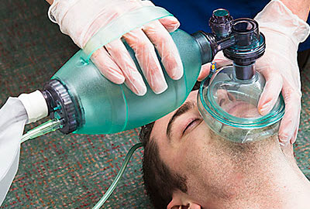
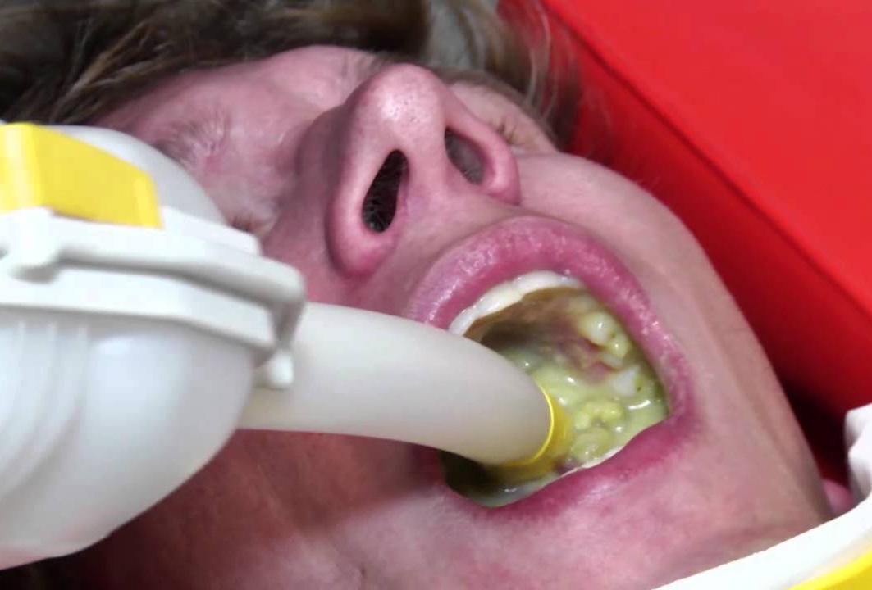
Modified Item: Lifeguard Theory & Practice
Additional knowledge of bag-valve-mask (BVM) and manual suction use.
Principle: These are valuable tools available to lifeguards to perform artificial respiration and manage complications (vomit, foam).
NLI Self Learning Guide
Notes:
BVM knowledge
Inform:
Additional resources will be available in the updated Teaching National Lifeguard resource
Stress:
BVM can deliver higher concentrations of Oxygen than a rescuer breathing through a pocket mask (16% Oxygen in exhaled air).
A BVM can deliver 21% Oxygen when delivering atmospheric air and up to 100% Oxygen when hooked up to a tank with compressed Oxygen.
This is of benefit since drowning patients typically suffer from hypoxia and require the higher amounts of Oxygen during resuscitation.
This is a skill that needs to be practiced and is more easily accomplished with two rescuers where one squeezes the BVM and the other maintains a proper seal of the mask and patent airway.
Manual suction knowledge:
Suction devices can aid with the removal of fluid and some solids from the airway.
They are not proficient at clearing foam from the airway and better patient outcomes have occurred with positive pressure ventilation (BVM) pushing the foam back into the patient and forcing it out of the alveoli.
Suctioning should be in addition to proper patient positioning to allow drainage.

Slide 33
New Item: Rescue Aid Proficiency
Demonstrate proficiency in the use of buoyant and non-buoyant aids appropriate for a variety of victim types in supervised environments.
Principle: Rescue aids are valuable tools that the lifeguard must have access to and practice using in order to become proficient.
NLI Self Learning Guide
Notes:
Rescue Aid Proficiency
Inform:
Additional resources will be available in the updated Teaching National Lifeguard resource
Examples of buoyant aids (page 5):
Rescue tube
Rescue can
Ring buoy
Adult lifejacket
PFD
Examples of non-buoyant aids (page 5):
Reaching pole
Throw bag
Line

Slide 34
New Item: Rescue Aid Proficiency
Watch the video (link in notes below)
NLI Self Learning Guide
Notes:
Take a moment to watch the video with the following link. This video is only for the purpose of Update Clinic and Self-Learning use, and is not designed to be used during a NL course.
Link: https://www.youtube.com/watch?v=y9GGResgEA0
Notes:
This video demonstrates various rescue aids with various techniques.
There is no single technique that is the standard for use with each individual rescue aid.
The purpose of the rescue aid is to be a helpful device for the lifeguard during a rescue. As long as the technique follows the description of the item, meets the purpose of the item, and adheres to the Must Sees of the item, it is deemed to be appropriate.

Slide 35
Modified Item: Scanning and Observation
Designated supervision zones are for illustration purposes only
NLI Self Learning Guide
Notes:
Use slide to highlight the lifeguard competencies.
Note that:
The illustrated zones above are for illustration purposes only, and are not implying that these are the operational surveillance zones at this particular facility.
Share that:
There are sample pool layouts included on the Teaching National Lifeguard USB that Instructors can incorporate as activities in their National Lifeguard courses.
Stress that:
Scanning and observation is now an item in a National Lifeguard Recertification, and can be evaluated synchronously while evaluating Lifeguard Emergency Situations.

Slide 36
Performance during Lifeguarding Situations
“The competency demonstrated by candidates in achieving the Must Sees in the skill test items should be evident in their performance in lifeguard situations.”
What does this principle mean?
Why is it important to understand?
Lifeguard
Knowledge
Judgment
Skill
Fitness
NLI Self Learning Guide
Notes:
Use slide to highlight the lifeguard competencies.
Stress that:
The updated NL curriculum is grounded in important lifeguard competencies
The 4 lifeguard competencies – judgment, knowledge, skill and fitness – are reflected throughout the revised National Lifeguard test items.

Slide 37
Teaching National Lifeguard USB
USB includes:
Lesson Plan & PowerPoint for NL Pool
Lesson Plan & PowerPoint for NL Waterpark
Lesson Plan & PowerPoint for NL Waterfront
Course Outlines
Test sheets
Handouts
NLI Self Learning Guide
Notes:
Now available for purchase as an individual item or as part of the National Lifeguard Instructor Pack.
www.LifeguardDepot.com

Slide 38
Session 4:
Management of Spinal-Injured Victim
Notes:
Notes:
Ensure you have, use and reference the National Lifeguard Award Guide accordingly for these items.
Please read the entire page of the Award Guide including the description, purpose, Must Sees, and notes.
Refer to the respective pages while reviewing these items.
Award Guide pages:
NLAG Pool: Page 20
NLAG Waterpark: Page 41
NLAG Waterfront: Page 62
NLAG Surf: Page 81
Important:
The main purpose of this skill is to focus on the importance of ABC assessment and initiating immediate CPR if the victim is not breathing.
Even though this topic has a dedicated session in this Self-Learning Guide, it’s important to note that the intention is not to over emphasize the importance of this item. One can perceive that since dedicated time is spent on this item in this Guide, that that this item has been “elevated in stature” over the rest – which is not the intent.

Slide 39
Modified Item: Management of Spinal-Injured Victim
FORMER
“Immobilization of head and neck”
UPDATED
“Motion of victim’s spine restricted”
NLI Self Learning Guide
Notes:
“We are all used to seeing “immobilization of head and neck” but now the change is to “motion of victim’s spine restricted”. Why do you think this change was made?
Justify this new language, and why this is there
Reverse engineer why you feel this is the case
This is the reason we are deemphasizing the “immobilization” aspect of the skill
We want them to walk away with understanding what their focus is (and what it is not) when they teach this item in NL
Definition of “RESTRICTED” in this context:
Restricted = movement is limited (but not “no movement what so ever”)
Notes:
Restricting or decreasing spinal motion comes in line with new industry standards in hospital and EMS treatment guidelines.
Backboards are used as extrication devices and collars are sized so that they work as a reminder for victims to try and limit their movement.
Victims that were taped and strapped to a hard board had detrimental outcomes to their recovery or became agitated and uncomfortable, causing them to "fight" the immobilization system and possibly aggravating the injury.
Victims should be coached to stay still to avoid complications.

Slide 40
Modified Item: Management of Spinal-Injured Victim
Description:
With the assistance of one back-up lifeguard or assistant lifeguard and one bystander, demonstrate effective management of suspected spinal-injured victims (breathing and non-breathing) found in water.
Principle: 3 personnel only (lifeguard + back-up + bystander)
Principle: This item is performed twice: once for a breathing victim and second for a non-breathing victim
NLI Self Learning Guide
Notes:
On screen is the direct item description printed in the Award Guide.

Slide 41
Modified Item: Management of Spinal-Injured Victim
Focus of this item:
Mechanism of injury
Impact
Victim signs & symptoms
Witnesses
Principle: If a spinal-injured victim stops breathing, resuscitation takes priority.
Donning of gloves should not delay start of resuscitation.
NLI Self Learning Guide
Notes:
Ensure that the focus is on spinal assessment (using judgment to make the appropriate call)
Mechanism of injury
Impact
Witnesses
Victim signs & symptoms
Notes:
Quickly, and efficiently assessing victim’s ABCs
If not breathing perform a safe and efficient removal to begin resuscitation as quickly as possible
This may include in water breaths if not able to extract victim right away
In Bronze Cross, there is “no deep water” so you may have to focus a bit more on this in NL
It is extremely important to focus on time to victim, if face down, to get them rolled over to allow for airway not being blocked by the water. Ensuring participants knowing that face down doesn't mean unconscious unless they are left to become asphyxiated.
The lifeguard that performs the rollover needs to be the “primary lifeguard” and dictate the board (backup lifeguard) where to set-up to ensure that motion is restricted (limited). Suggest that there is only one walking turn max, unless there is someone on the hips to pivot on the spot. Primary lifeguard is in charge.
Remind technique used to open the airway for spinal victims is jaw-thrust. If a jaw-thrust is ineffective, then a head-tilt chin-lift is used.
Additionally:
The jaw thrust is taught only in the NL course and is not instructed in EFA or SFA courses.
A jaw thrust should be the first attempted technique to open the airway however if it fails, then resort to a head-tilt chin-lift.

Slide 42
Modified Item: Management of Spinal-Injured Victim
Watch the video (link in notes below)
NLI Self Learning Guide
Notes:
Take a moment to watch the video with the following link. This video is only for the purpose of Update Clinic and Self-Learning use, and is not designed to be used during a NL course.
Link: https://www.youtube.com/watch?v=g4tINkf6Vjc
Notes:
This video demonstrates a single method of managing a spinal-injured victim that is unconscious and non-breathing. However, there are other techniques that will also meet the requirements of this item in both the Must Sees and purpose of the item.
There is no single technique that is the standard. As long as the technique follows the description of the item, meets the purpose of the item, and adheres to the Must Sees of the item, it is deemed to be appropriate.

Slide 43
Modified Item: Management of Spinal-Injured Victim
Additional reminders:
Quickly, and efficiently assess the victim’s ABCs.
If not breathing, perform a safe and efficient removal to begin resuscitation as quickly as possible.
This may include in-water breaths if not able to extract victim right away.
Reminder that in Bronze Cross (2020), there is “no deep water spinal rollover,” so you may have to focus a bit more on this in NL.
NLI Self Learning Guide
Notes:
Reference the National Lifeguard Award Guide accordingly.

Slide 44
Modified Item: Management of Spinal-Injured Victim
Answer the following questions to yourself, before reading the answers in the notes:
What if the jaw thrust does not open the airway?
If performing rescue breathing on a spinal victim in water, may I stop rescue breathing to stabilize the victim on a spineboard?
What lifesaving kick is used to perform the mandatory deep end spinal carry?
NLI Self Learning Guide
Notes:
Q1: What if the jaw thrust does not open the airway?
A1: Use Head-tilt/Chin-lift to open the airway.
…
Q2: If performing rescue breathing on a spinal victim in water, may I stop rescue breathing to stabilize the victim on a spineboard?
A2: The priority becomes resuscitation if a victim is not breathing. Immediately focus on a safe and effective removal to begin CPR on deck. A “spinal board removal” is not necessary and in fact not advisable as it will delay CPR. The “problem” is lack of oxygen and no longer the spine – so we need to treat by giving oxygen ASAP (c/o CPR).
…
Q3: What lifesaving kick is used to perform the mandatory deep end spinal carry?
A3: The deep end spinal carry that was part of the former management of spinal-injured victim has been removed and no longer a requirement. However, the candidates should still be taught various rollover techniques and transportation methods which would include lifesaving kicks (whip kick, scissor, inverted scissor and eggbeater). It is recommended that candidates use eggbeater kick as referenced in the Canadian Lifesaving Manual.

Slide 45
Session 5:
Single Lifeguard Situations
Notes:
Notes:
The significant change to the situations item is the clarification of what the expectations of the single lifeguarding scenarios. Very little change to the team situations.
Ensure you have, use and reference the National Lifeguard Award Guide accordingly for this item.
Please read through at this time the respective items for Pool and Waterfront found on:
NLAG Pool: Page 22
NLAG Waterfront: Page 64

Slide 46
Lifeguard Situation: Single Guard
IT IS:
Only lifeguard that is working
1 lifeguard responding, while other lifeguards are “supervising” the pool
IT IS NOT:
NLI Self Learning Guide
Notes:
This item was evaluated in the former National Lifeguard program; however it was incorporated into the Lifeguard Situations item and often not evaluated. This item is now a stand-alone item, to ensure that it is always evaluated.
There are many aquatic operations across Canada that only require 1 lifeguard to open, and therefore since this is a National Lifeguard certification valid across the country, anyone that holds the award needs to be competent and proficient to lifeguard any pool.
What does “single lifeguard situation” look like (what is it, and what it is not)?
Is = only lifeguard working
Not = 1 lifeguard responding, while the other lifeguards are “supervising”
Notes:
Situational awareness that if back-up lifeguards aren't responding (due to unforeseen reasons) that the lifeguard may have to get more assistance from bystanders that originally anticipated.
Pay particular attention to the notes on this item, as they provide important and valuable information to the Instructor and Examiner

Slide 47
Lifeguard Situation: Single Guard
National Lifeguard is a national program. Our aquatic operations across the country includes municipal, YMCA, privately owned swim schools, overnight camps, residential pools, campgrounds, and more.
NLI Self Learning Guide
Notes:
There are various supervised operations across Canada, and many do lifeguard as a single-lifeguard even though you may not at your workplace.

Slide 48
Lifeguard Situation: Single Guard
The Item
The Must Sees
Teaching Strategies
Best Practices
Lifeguarding vs Lifesaving Techniques
Designing Situations
As a single lifeguard, respond to a situation in a supervised aquatic setting with one auxiliary staff member.
NLI Self Learning Guide

Slide 49
Lifeguard Situation: Single Guard
The Item
The Must Sees
Teaching Strategies
Best Practices
Lifeguarding vs Lifesaving Techniques
Designing Situations
Take a moment to review all of the Must Sees for this item.
NLI Self Learning Guide

Slide 50
Lifeguard Situation: Single Guard
The Item
The Must Sees
Teaching Strategies
Best Practices
Lifeguarding vs Lifesaving Techniques
Designing Situations
A lifeguard acting alone is at higher risk than lifeguards responding as a team.
Single lifeguards should follow the Ladder Approach and employ the lowest-risk rescue techniques possible under the circumstances.
Rescue aids offer the lifeguard a degree of personal protection. Use of rescue aids is encouraged.
NLI Self Learning Guide

Slide 51
Lifeguard Situation: Single Guard
The Item
The Must Sees
Teaching Strategies
Best Practices
Lifeguarding vs Lifesaving Techniques
Designing Situations
Question:
What are strategies that you can use to teach and evaluate this item?
NLI Self Learning Guide
Notes:
5-7 Minutes: Have groups report on various methods in creating lifeguard situations with reference to:
The benefits or features of their method. E.g. allows for quick feedback, time management allowing for lots of practice time, etc.
List three or more factors when considering how to set up a lifeguard situation. E.g. Number of candidates, beginning of course requiring a walk through or demo of a guard situation, etc.
How is feedback delivered? E.g. Instructor-lead versus peer feedback, and when is it delivered?
Strategy 1:
While ensuring that there are a minimum of 6 potential victims, split the group into 2 or 3 (to have a group size of at least 6 people).
Group 1: to prepare to lifeguard as a single guard and waits in an area away from the pool (e.g. pool change room so they are not in hearing/seeing distance).
Group 2: will be assigned various victim types (all the same one, or variety) and are also numbered. Victims are given cues including a non-verbal cue of when to go (e.g. Examiner sips water from a water bottle).
One at a time the lifeguard proceeds to supervise the pool with the mock patrons swimming around (the others wait in the off-deck area available).
When the Examiner performs the assigned cue, the victim proceeds to act out their victim type. Lifeguard responds accordingly.
The Examiner can proceed to allow the lifeguard to continue performing the appropriate rescue, while Lifeguard #2 comes on deck to begin their turn.
Continue the staggered start, until the lifeguard group is finished. Then switch lifeguard-victim groups and repeat so that everyone has a turn.
Note: There must be an auxiliary staff member available to the back-up guard for this item. Options may include: the lifeguard from Group 1 that just completed their skill, an assigned member from Group 2 (the victim group) that will be the bona-fide auxiliary staff member for all lifeguards, etc.
Key factors for creating successful and efficient lifeguard situations used to evaluate a single lifeguard situation.
Such as:
Realistic victim scenarios
Time needed to set up
Appropriate first aid supplies at hand
Where possible a victim simulation kit should be used to help portray realistic victim types (e.g. make-up, red food colour for bleeding, oatmeal for vomit, medical alerts, empty pill bottles, petroleum jelly and Plasticine for wounds, etc.) See Instructor Manual, Teaching Resuscitation and First Aid.
Specialized techniques or skills have been instructed for a particular situation, e.g. double clutch rescues

Slide 52
Lifeguard Situation: Single Guard
The Item
The Must Sees
Teaching Strategies
Best Practices
Lifeguarding vs Lifesaving Techniques
Designing Situations
As a single lifeguard, respond to a situation in a supervised aquatic setting with one auxiliary staff member.
Question:
What are best practices when teaching and evaluating this item?
NLI Self Learning Guide
Notes:
Notes:
Throughout the Award Guide there are many notes pertaining to setting up lifeguard situations (single guard and team situations).
NLAG Page vi: Note to National Lifeguard Instructors
NLAG: Test items
NLAG: Appendix A
Additionally, take a moment to review the Bronze Medals Award Guide (2020):
Appendix A: Designing Assistant Lifeguard Situations

Slide 53
Lifeguard Situation: Single Guard
The Item
The Must Sees
Teaching Strategies
Best Practices
Lifeguarding vs Lifesaving Techniques
Designing Situations
Scenarios may include any of the test items within the National Lifeguard option (e.g., public relations, drowning non-swimmer, submerged victim, spinal-injured victim, injured swimmer, facility emergency, environmental emergency).
Note: first aid conditions are limited to those outlined in Appendix A.
NLI Self Learning Guide
Notes:
In lifeguard situations, scenarios may include any of the test items within the National Lifeguard option (e.g., public relations, drowning non-swimmer, submerged victim, spinal-injured victim, injured swimmer, facility emergency, environmental emergency). Note that first aid conditions are limited to those outlined in Appendix A.
Situations should be simple, realistic and based on those commonly encountered by lifeguards in real life. Examiners will adapt scenarios to a pool, waterpark, waterfront or surf environment (e.g., heat exhaustion in a pool setting could be caused by sauna use versus sun exposure at a waterfront).
Recent statistics show that lifeguards most commonly deal with drowning non-swimmer and minor wound (nosebleeds, minor cuts and scrapes) interventions. When designing scenarios for specific user groups or facilities, ensure that they are realistic (e.g., children are more likely to require a public relations intervention for a rule infraction; adult swimmers are more likely to suffer from a medical emergency; an allergy attack may be more realistic in an outdoor environment with a bee sting). Situations that may/may not involve first aid treatments include:
Public relations (e.g., rule infractions, facility inquiries, unsupervised toddlers, missing person)
Facility emergencies (e.g., chlorine gas leak, power outage, fire alarm)
Environmental dangers (storm, cold weather/water, waves, rip tides, etc.)
Each scenario set of 3 or 4 situations should include a DNS (minor or major), a wound management scenario and/or other first aid intervention (minor or major), and a public relations or facility/environmental emergency.
The design and number of minor and major emergencies needs to ensure that all candidates have an opportunity to demonstrate to the evaluator’s satisfaction that they are performing at the National Lifeguard standard.
Design the majority of situations to occur in the water.
With reference to the National Lifeguard Examination Policy, the minimum number of simulated patrons is 6. More is recommended, but 6 is the minimum. (the back-up of the untrained (NL) staff member is on top of the 6 participants. That would ensure that the 8 people minimum for an exam is maintained.)

Slide 54
Session 6:
Next Steps

Slide 55
National Lifeguard Instructors
Next Steps
Notes:
Thank all for following this Self-Learning Guide. Should you have any questions about the National Lifeguard program, please send us an email at training@lifeguarding.com.

